Slide 1


Joana Ceci
26-08-2023

Slide 2

Outline
Executive Summary
Introduction
Methodology
Results
Conclusion
Appendix

Slide 3
Introduction
SpaceX advertises Falcon 9 rocket launches on its website with a cost of 62 million dollars; other providers cost upward of 165 million dollars each, much of the savings is because SpaceX can reuse the first stage.
The project task is to predict if the Falcon 9 first stage will land successfully.

Slide 4

Section 1

Slide 5
Methodology
Executive Summary
Data collection methodology:
SpaceX Rest API
Perform data wrangling
Checking for null values and irrelevant columns
Perform exploratory data analysis (EDA) using visualization and SQL
Perform interactive visual analytics using Folium and Plotly Dash
Perform predictive analysis using classification models
Linear regression , k-nearest neighbors, Support vector machine Decision tree

Slide 6

Data Collection
SpaceX launch data that is gathered from SpaceX REST API
The SpaceX REST API endpoints, or URL, starts with api.spacexdata.com/v4/.
The columns from data frame who will work for learning about launches are :
rocket, we would like to learn the booster name
payloads, we would like to learn the mass of the payload and the orbit that it is going to
lauchpad, we would like to know the name of the launch site being used, the longitude, and the latitude.
cores, we would like to learn the outcome of the landing, the type of the landing, number of flights with that core, whether gridfins were used, whether the core is reused, whether legs were used, the landing pad used, the block of the core which is a number used to seperate version of cores, the number of times this specific core has been reused, and the serial of the core.
SpaceX REST API
Return SpaceX in JSON
Normalize data into csv file
Ready for data consolidation and wrangling

Slide 7
Data Collection – SpaceX API
Data collection with SpaceX API
https://github.com/J-CECI/FINAL.md/blob/main/WEEK%201-%20API.ipynb

Slide 8
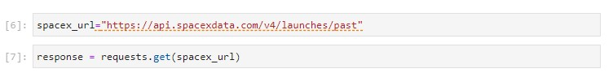
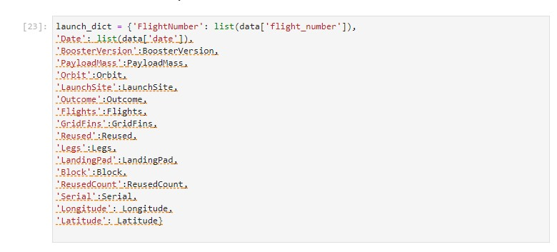
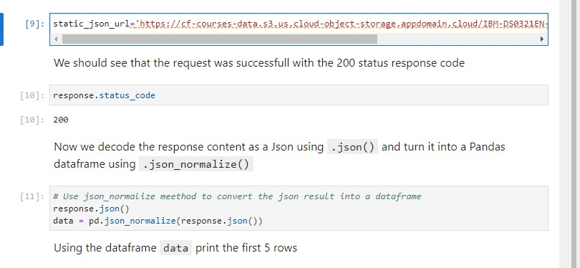
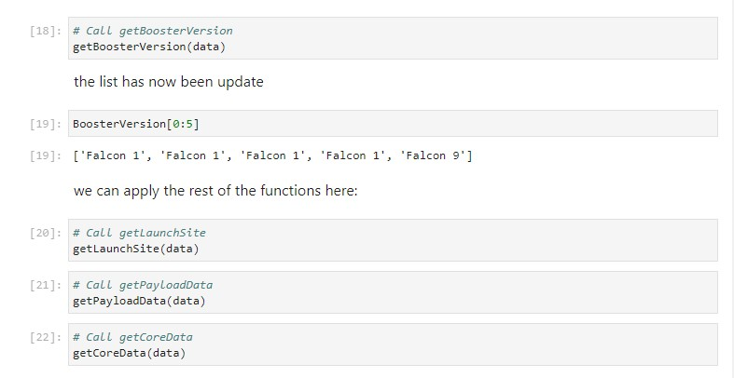
Data Collection – SpaceX API

Slide 9
Data Wrangling
First we check for null values.
In the second stage :
Calculate the number of launches on each site
Calculate the number and occurence of each orbit
Calculate the number and occurence of mission outcome per orbit type
Create a landing outcome label from Outcome column
After that we handle null values
https://github.com/J-CECI/FINAL.md/blob/main/WEEK%201%20-Data%20Wrangling.ipynb

Slide 10
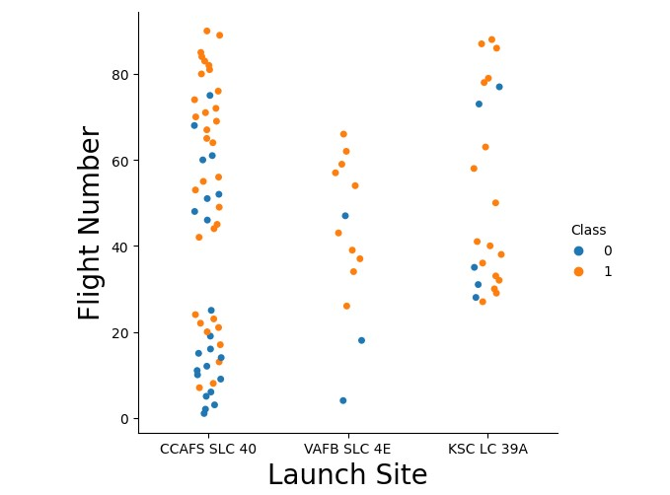
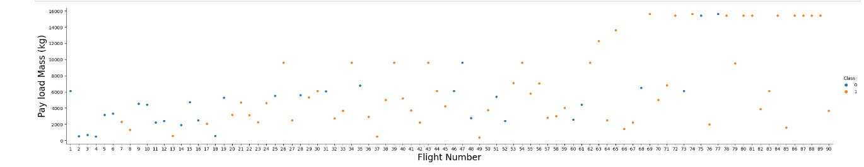
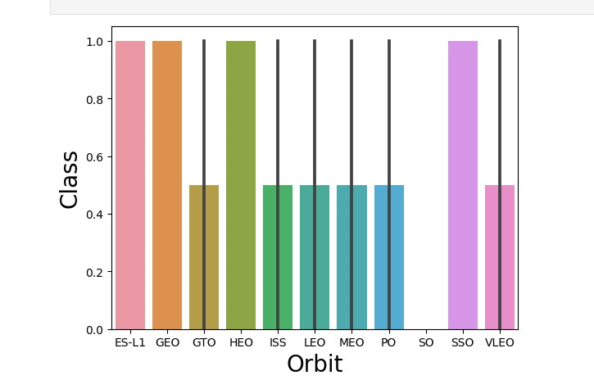
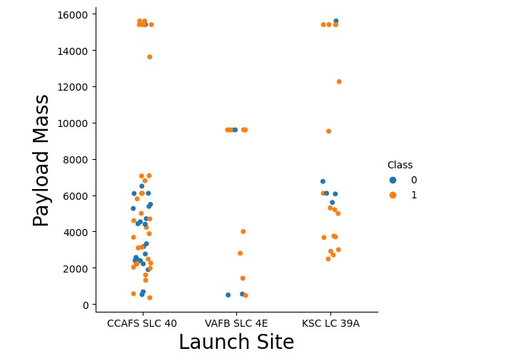
EDA with Data Visualization
https://github.com/J-CECI/FINAL.md/blob/main/WEEK%202%20-EDA%20VISUALIZATION.ipynb

Slide 11
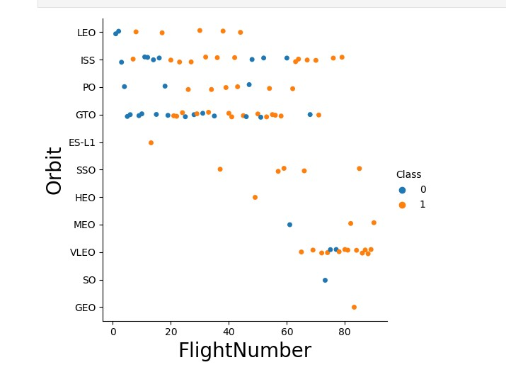
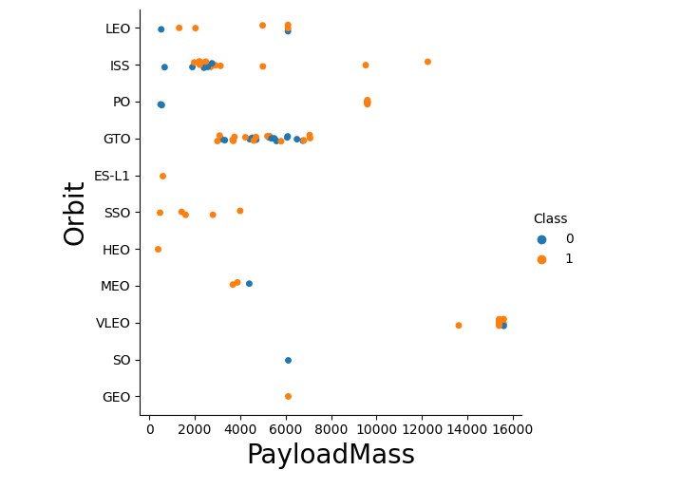
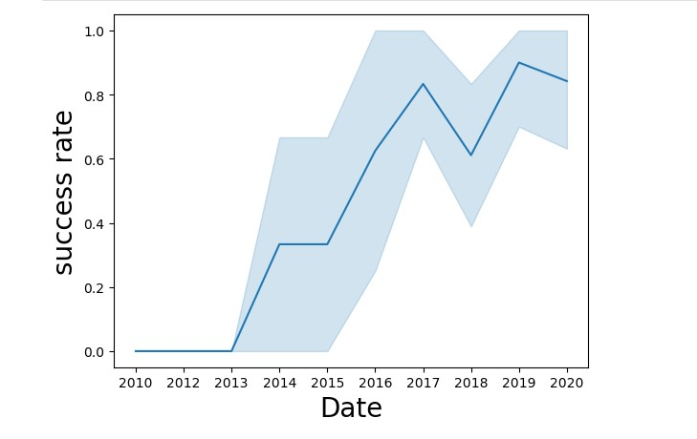
EDA with Data Visualization
https://github.com/J-CECI/FINAL.md/blob/main/WEEK%202%20-EDA%20VISUALIZATION.ipynb

Slide 12
​
EDA with SQL
Display the names of the unique launch sites in the space mission
Display 5 records where launch sites begin with the string 'CCA’
Display the total payload mass carried by boosters launched by NASA (CRS)
Display average payload mass carried by booster version F9 v1.1
List the date when the first succesful landing outcome in ground pad was acheived.
List the names of the boosters which have success in drone ship and have payload mass greater than 4000 but less than 6000
List the total number of successful and failure mission outcomes
List the names of the booster_versions which have carried the maximum payload mass. Use a subquery
​List the records which will display the month names, failure landing_outcomes in drone ship ,booster versions, launch_site for the months in year 2015
Rank the count of landing outcomes (such as Failure (drone ship) or Success (ground pad)) between the date 2010-06-04 and 2017-03-20, in descending order.
https://github.com/J-CECI/FINAL.md/blob/main/WEEK%202%20SQL.ipynb

Slide 13
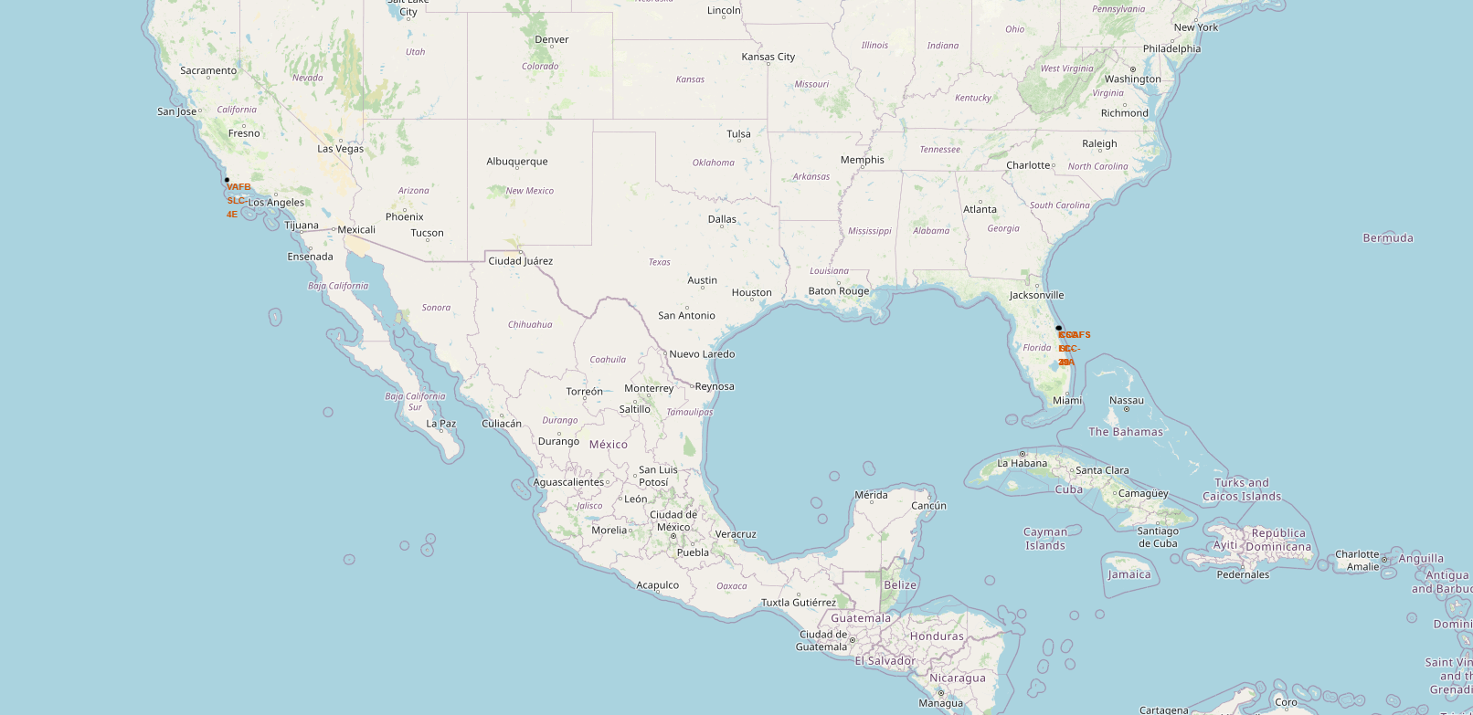
Build an Interactive Map with Folium
https://github.com/J-CECI/FINAL.md/blob/main/WEEK%203%20LAUNCH%20SITES.ipynb

Slide 14
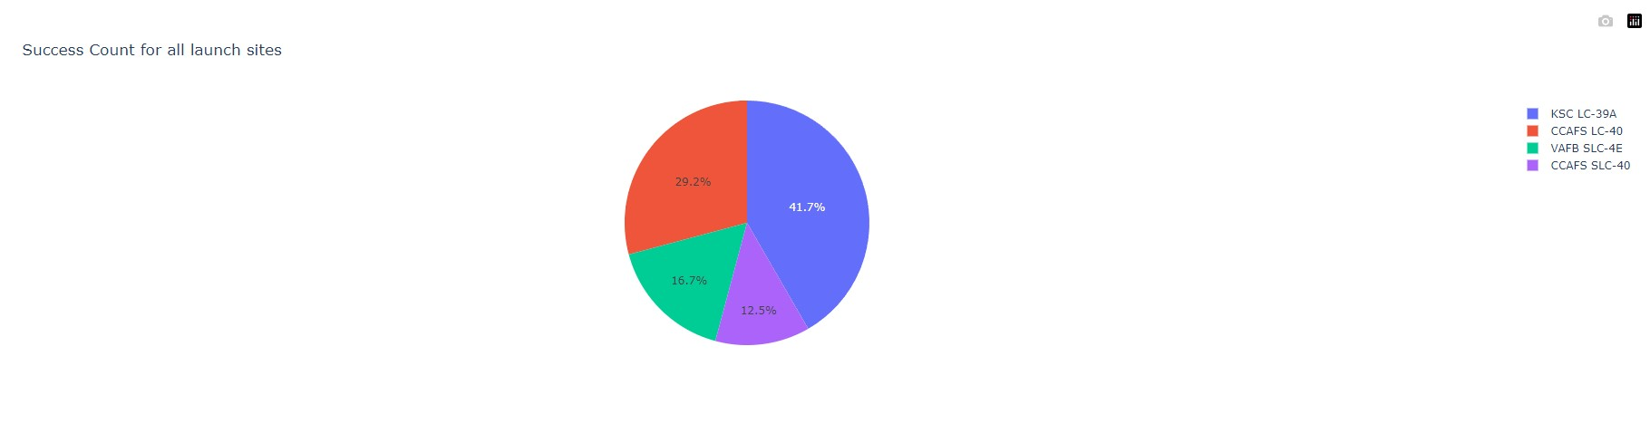
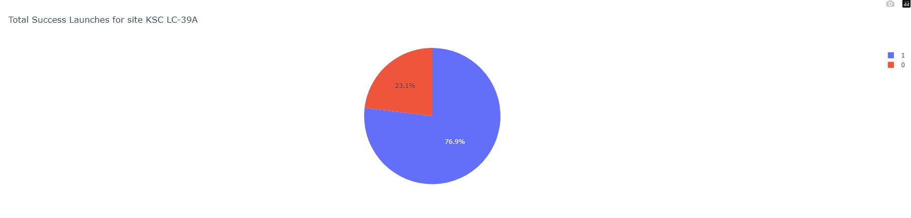
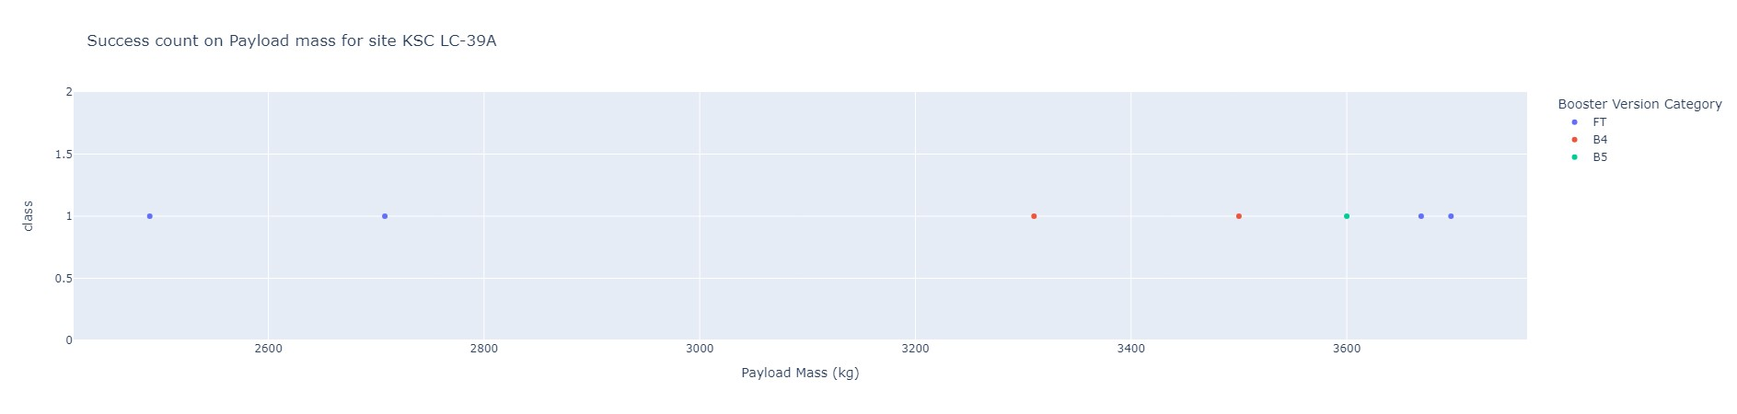
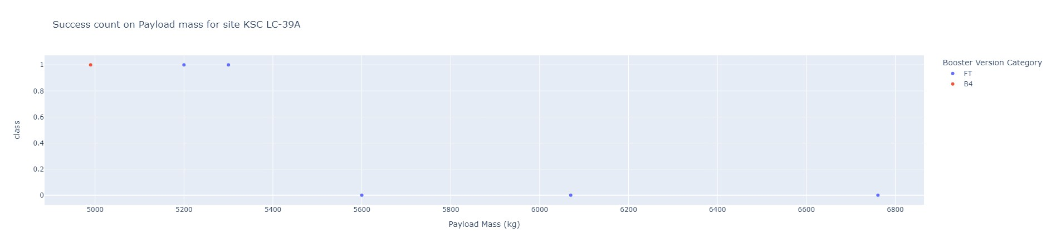
Build a Dashboard with Plotly Dash
https://github.com/J-CECI/FINAL.md/blob/main/WEEK%203%20DASH_APP.py

Slide 15

Section 2

Slide 16
Flight Number vs. Launch Site
The most of Launches CCAFS SLC 40 are significantly higher than launches from other sides

Slide 17
Payload vs. Launch Site
A scatter plot of Payload vs. Launch Site
The most of Pay Load with lower Mass have been launched from CCAFS SLC 40.

Slide 18
Success Rate vs. Orbit Type
A bar chart for the success rate of each orbit type
From the bar charts the orbit types ES-L1,GEO,HEO,SSO have the highest success rate.

Slide 19
Flight Number vs. Orbit Type
A scatter point of Flight number vs. Orbit type
From the graph we can observe the shifting to VLEO launches in recent year.

Slide 20
Payload vs. Orbit Type
The most significant trend are:
The correlation between ISS and Payload at the range 2000, and
The correlation between GTO and the range of 4000-8000.

Slide 21
Launch Success Yearly Trend
line chart of yearly average success rate
Launch success rate from 2013 despite same fluctuations followed an upward trend.

Slide 22
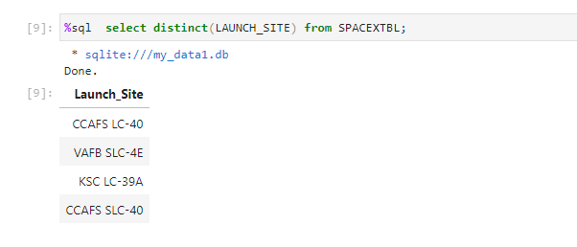
All Launch Site Names

Slide 23
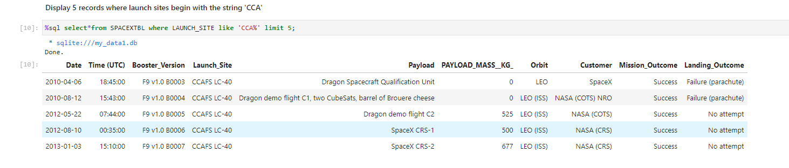
Launch Site Names Begin with 'CCA'

Slide 24
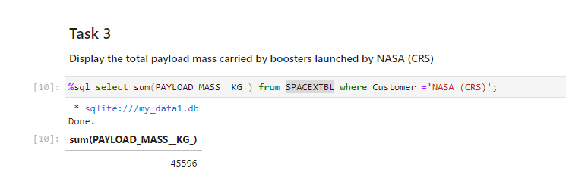
Total Payload Mass

Slide 25
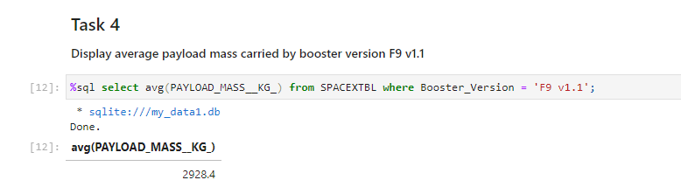
Average Payload Mass by F9 v1.1

Slide 26
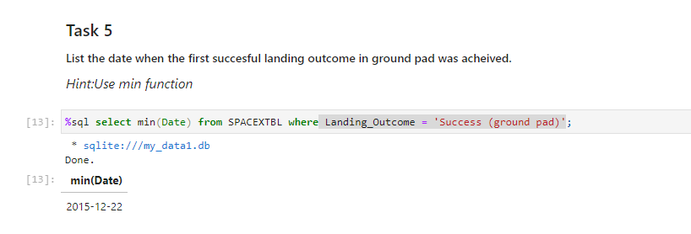
First Successful Ground Landing Date

Slide 27
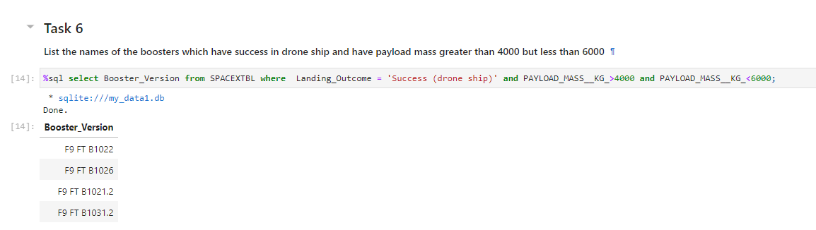
Successful Drone Ship Landing with Payload between 4000 and 6000

Slide 28
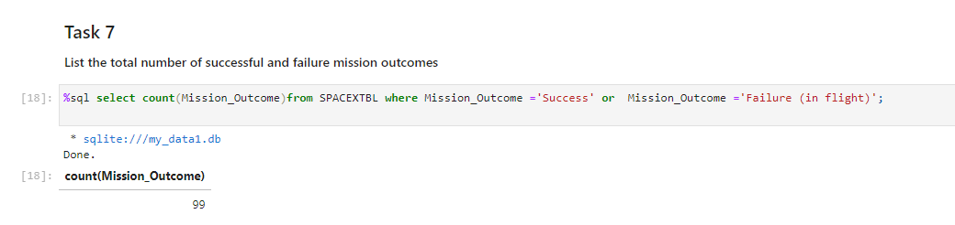
Total Number of Successful and Failure Mission Outcomes

Slide 29
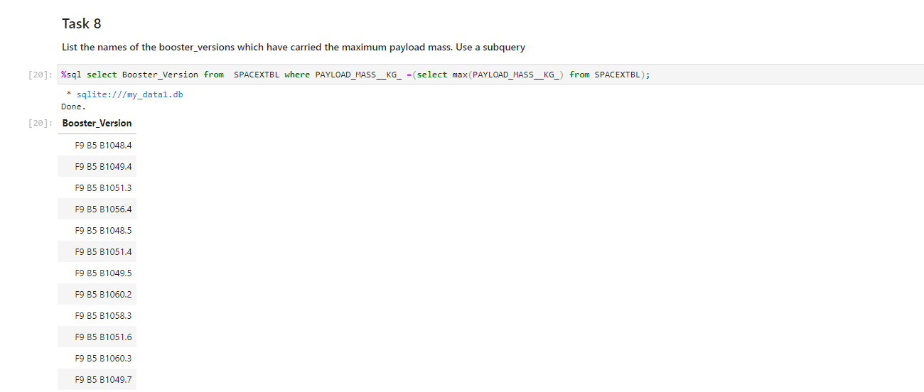
Boosters Carried Maximum Payload

Slide 30
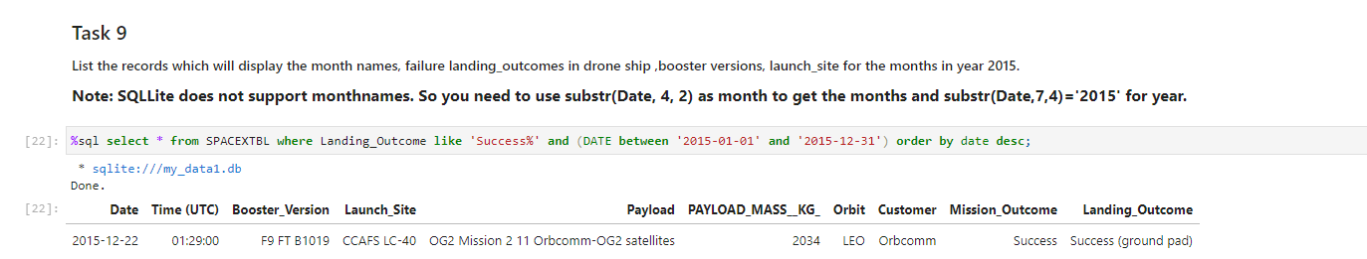
2015 Launch Records

Slide 31
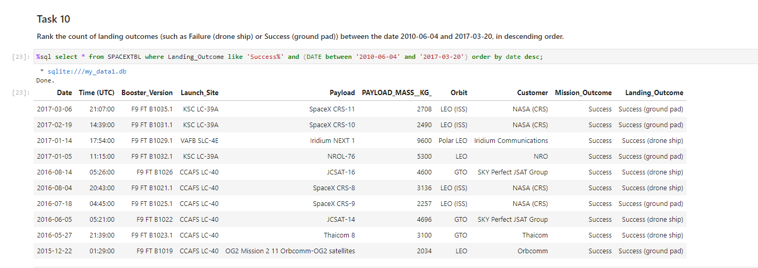
Rank Landing Outcomes Between 2010-06-04 and 2017-03-20

Slide 32

Section 3

Slide 33
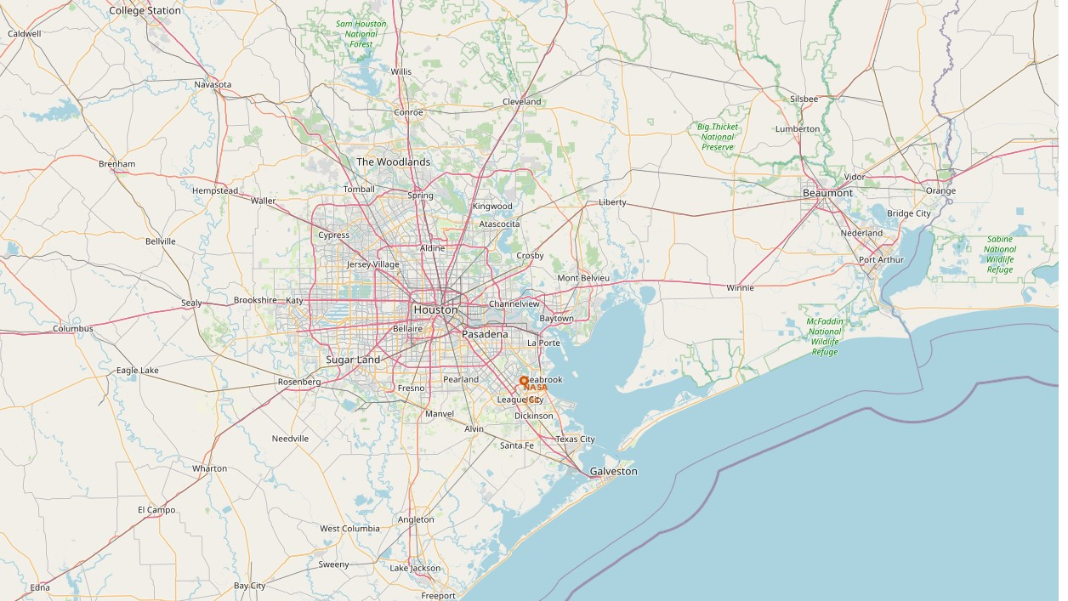
All launch sites on a map

Slide 34
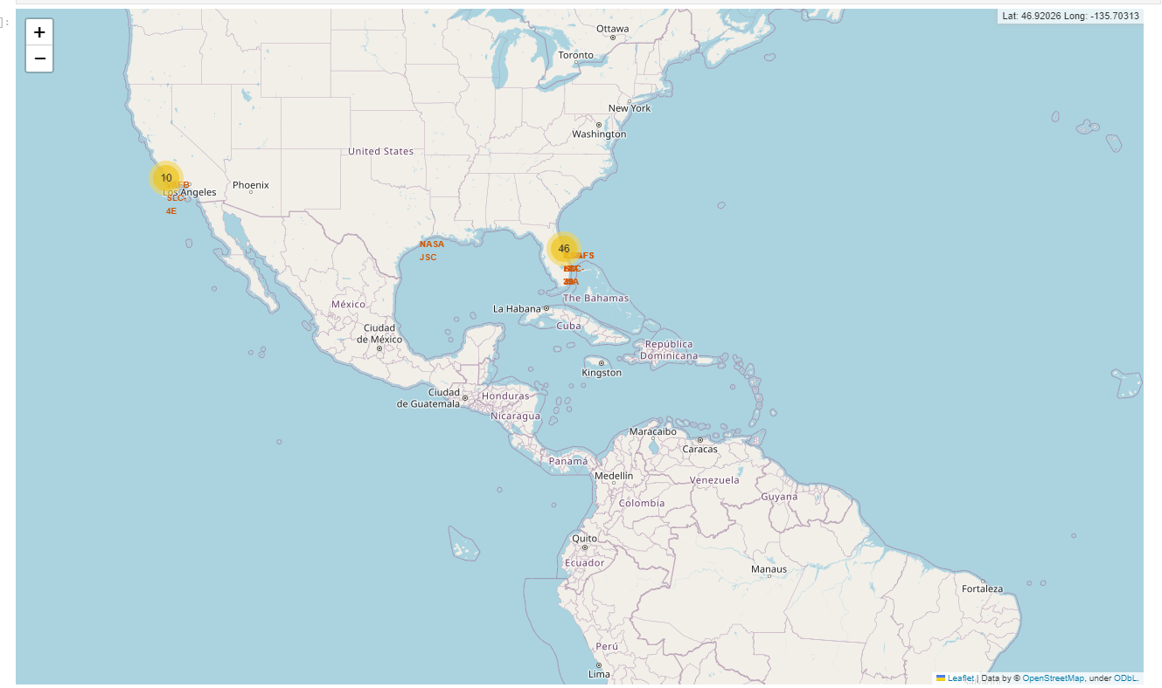
Success/failed launches for each site on the map

Slide 35
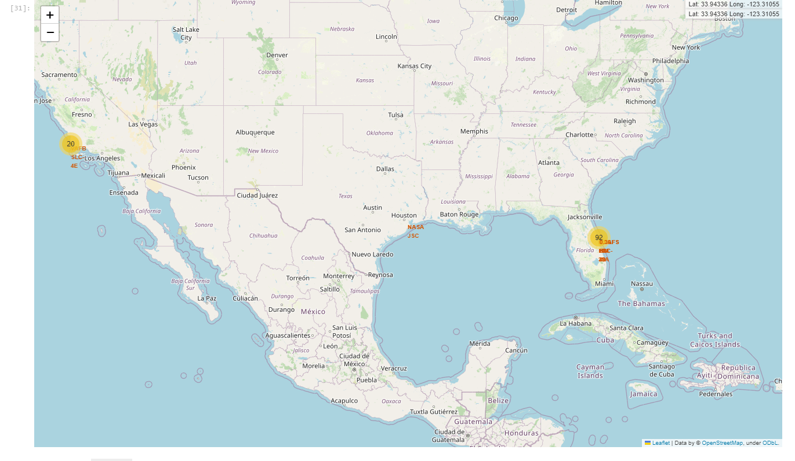
Calculate the distances between a launch site to its proximities

Slide 36

Section 4

Slide 37
Total success launches by all sites

Slide 38
Success rate by site

Slide 39
Payload vs launch outcome

Slide 40

Section 5

Slide 41
Classification Accuracy
Logistic Regression : logreg_cv.score(X_test,Y_test) : 0.833
KNN :Knn_cv.score(X_test,Y_test) :
SVM : svm_cv.score(X_test,Y_test):
Decision Tree Classifier : tree_cv.score(X_test,Y_test) :
https://github.com/J-CECI/FINAL.md/blob/main/WEEK%204%20ML.ipynb

Slide 42
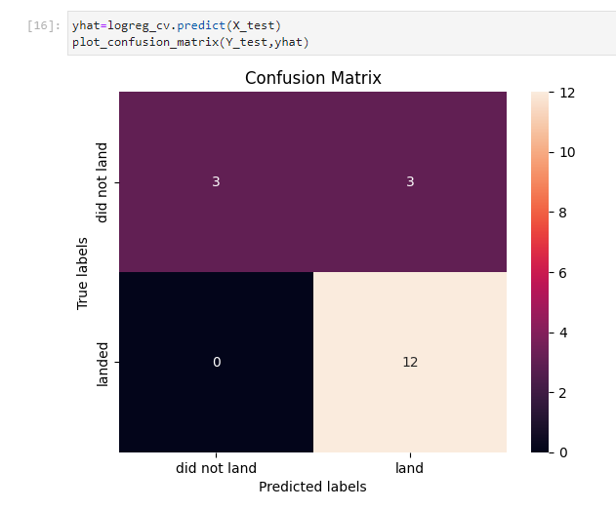
Confusion Matrix

Slide 43
Appendix
Include any relevant assets like Python code snippets, SQL queries, charts, Notebook outputs, or data sets that you may have created during this project

Slide 44


